Slide 1
A hands-on approach on botnets for a learning purpose
Computer Systems Security

Slide 2
Agenda
Botnet anatomy
History
Countermeasures
Botnet Wiki
Botnet Lab
Demo

Slide 3
Anatomy of a botnet
What is a botnet?
“A botnet is a number of Internet-connected computers communicating with other similar machines in an effort to complete repetitive tasks and objectives.”
In Wikipedia

Slide 4
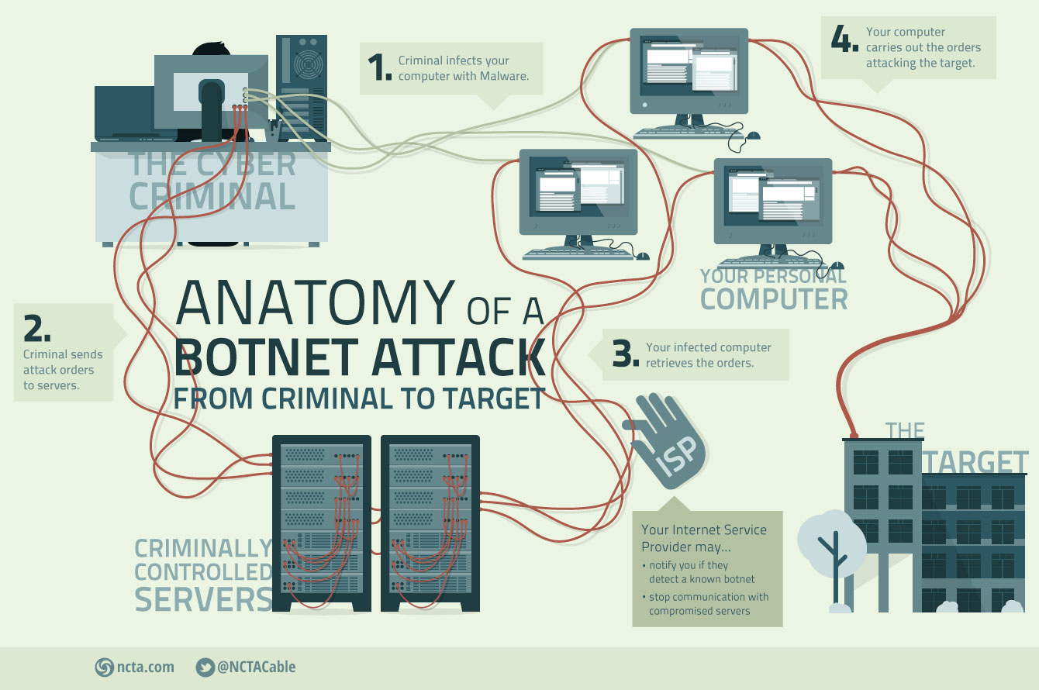

Slide 5
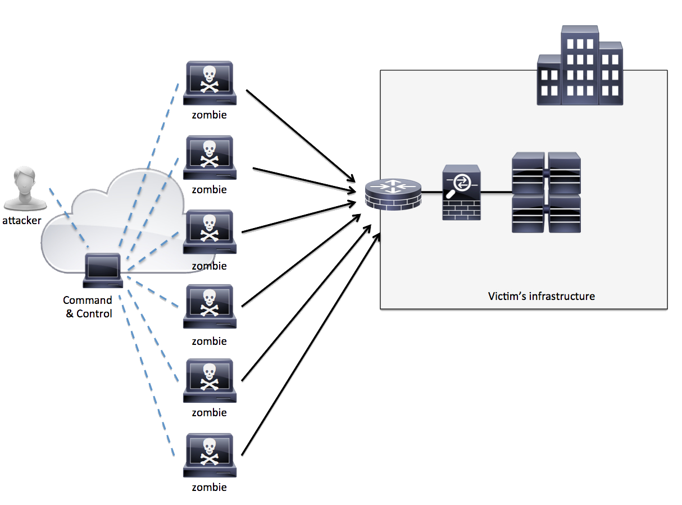
Botnet organization

Slide 6
Type of bots
Agobot
There are more than 500 known different versions of Agobot and this number is increasing. The bot itself is written in C++ .
SDBot
SDBot is written in very poor C. It is the father of RBot, RxBot, UrBot, UrXBot, JrBot,...
mIRC-based Bots (GT-Bots)
These bots launch an instance of the mIRC chat-client with a set of scripts and other binaries.

Slide 7
Types of attacks
DDoS
Spamming
Sniffing Traffic
Keylogging

Slide 8
Types of attacks
Bot
Spreading new Malware
Installing Advertisement Addons
Google AdSense abuse
Attack IRC Chat Networks
Manipulating online polls and games
Mass identity theft

Slide 9
History of botnets
2004
Bagle
2006
Rustock
Capable of sending up to 25,000 spam messages per hour from an infected PC.
2007
Cutwail
It uses a Trojan component called Pushdo to infect a machine.
Mass-mailing computer worm affecting all versions of Microsoft Windows.
Notes:
Most of the botnets detected until today are somehow related to sending enourmous amounts of e-mails, especially spam.
Be aware that the estimated number of bots presented below are just that because in some countries it is common that users change their IP address several times a day.
Bagle Est. no of bots: 230 000; Uses its own SMTP engine to mass-mail itself as an attachment to recipients.
Rustock Est. no of bots: 150 000; It uses self-propagation by sending malicious e-mails with a trojan incorporating the targeted machine into the botnet.
Akbot (2007) Est. no of bots: 1 300 000; It operates by joining IRC servers and then waiting for further instructions. Once installed, Akbot can be used to gather data, kill processes, or perform DDOS attacks.
Cutwail Est. no of bots: 1 500 000; It uses a Trojan component called Pushdo to infect a machine.

Slide 10
History of botnets
2008
Conficker
2009
BredoLab
Botnet mostly involved in viral e-mail spam.
2010
TDL-4
It’s a rootkit that runs the botnet (also known as Alureon).
Uses flaws in Windows OS software and dictionary attacks on administrator passwords to propagate itself.
Notes:
Conficker Est. no of bots: 10 500 000+; The botnet uses flaws in Windows OS software and dictionary attacks on administrator passwords to propagate itself.
BredoLab Est. no of bots: 30 000 000; “A district court sentenced 27-year-old Georgy Avanesov, a Russian citizen of Armenian descent, to four years in prison on charges of creating and spreading the Bredolab virus”.
TDL-4 Est. no of bots: 4 500 000+; It infects the master boot record of the target machine, making it harder to detect and remove.

Slide 11
History of botnets
2011
ZeroAccess
2012
Nitol
Botnet mostly involved in spreading malware and distributed denial-of-service attacks.
2014
Semalt (aka Soundfrost)
It visits random websites to generate referral and spies on users browsing habits.
Is a botnet mostly involved in bitcoin mining and click fraud.
Notes:
ZeroAccess Est. no of bots: 2 000 000; It uses a Trojan horse computer malware that affects Microsoft Windows operating systems and downloads other malware on an infected machine while remaining hidden by using rootkit techniques.
Nitol Est. no of bots: unknown; The botnet is mostly prevalent in China where an estimate 85% of the infections are detected. It was found to be present on systems that came brand-new from the factory, indicating the trojan was installed somewhere during the assembly and manufacturing process.
Semalt (aka Soundfrost) Est. no of bots: 300 000+; Semalt is a botnet mainly involved mainly involved in sending spam e-mails.

Slide 12
Botnet detection
Some of the common activities one could monitor to detect botnets are:
opening of specific ports
establishing a number of unwanted network connections
downloading and executing files and programs
creating new processes with well-known names
disabling antivirus software

Slide 13
Botnet detection
Signature-Based
Anomaly-Based
Perform botnet detection by considering several different network traffic anomalies, including high network latency, high traffic volume, traffic on unusual ports, and unusual system behavior.
A signature-based Botnet detection technique uses the signatures of current Botnets for its detection. This method has several advantages, such as very low false alarm rate.

Slide 14
Botnet countermeasures
Blacklisting
Packet Filtering
A typical component that performs packet filtering at host level is a desktop firewall. Its purpose is to monitor the network activities of all active processes.
A blacklist can be used to block all traffic from included addresses and also to filter websites with suspicious or proven malicious contents.
Reverse Engineering
Port Blocking
The malware reverse engineering technique helps in extracting the details of the installation and spreading of malware.
Is a preventive measure that can be applied by ISPs to reducing the amount of spam mails traversing their network.

Slide 15

Botnet Wiki

Slide 16
Concept
For knowledge sharing about botnets, its influence in the current technological world and to share this information with the largest number of people, we built a website, the botnet wiki.

Slide 17
Technologies
Web Technologies
Jekyllrb
Markdown

Slide 18
Wiki Content
Anatomy
History
Countermeasures
Type of attacks
Types of bots
How and What
List of botnets
Good uses
Detection
Defense
Botnet Lab
Setup
Architecture

Slide 19
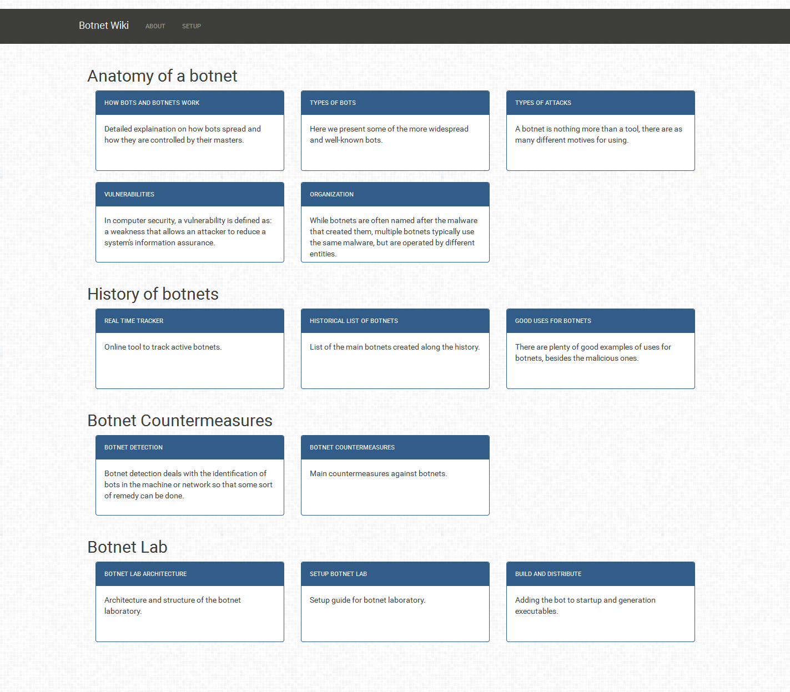
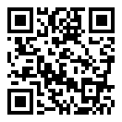
Available at:
http://jpdias.github.io/botnet-lab

Slide 20

Botnet Laboratory

Slide 21
Concept
With the intuit of having a real hands-on tool for testing and developing proposes we created a botnet lab framework, a botnet kit based on the IRC communication protocol, with built-in functionalities and an easy way of expanding functionalities, in a framework way.

Slide 22
Technologies
Python 2.7
IRCd-Hybrid Server
Cross-Platform

Slide 23
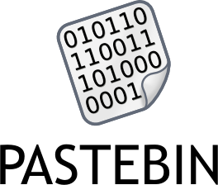

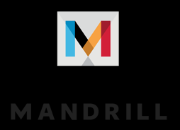

Technologies – External API’s

Slide 24
Functionalities
IRC Bot
Keylogger
DDoS
Spam
Webcam Control
Remote Command Execute
Screenshot

Slide 25
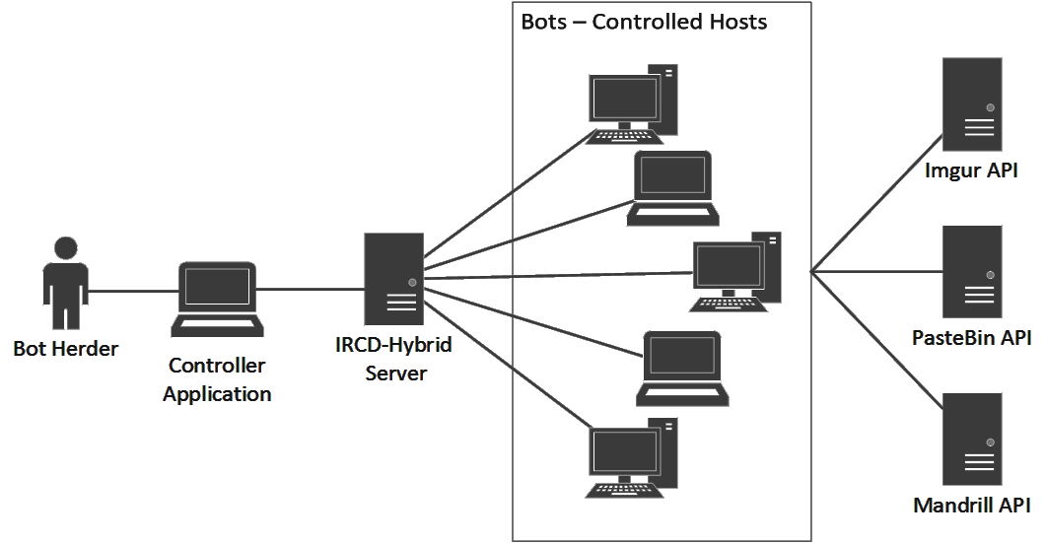
Architecture

Slide 26
Development Principles
Keep it simple, stupid! (KISS)
Secure all the communications
Using RSA (Public-key encryption)
Open-source
Contribution friendly through GitHub

Slide 27
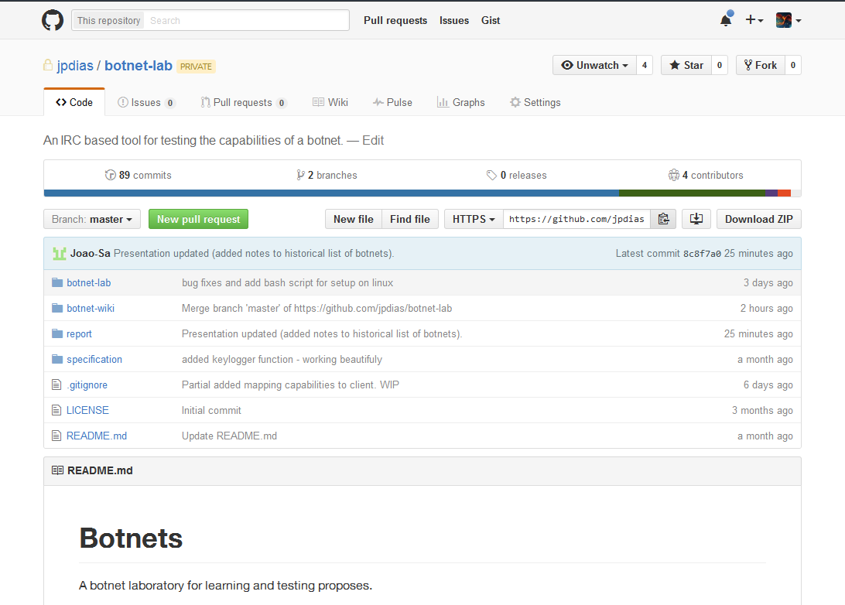
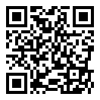
Available at:
http://github.com/jpdias/botnet-lab

Slide 28

Demo

Slide 29
Q & A
Thank you!
Group 6 – Theme 12
Eduardo Martins (ei11104@fe.up.pt)
João Pedro Dias (ei11137@fe.up.pt)
Jose Pedro Pinto (ei12164@fe.up.pt)
João Sá (ei11142@fe.up.pt)

